Slide 1
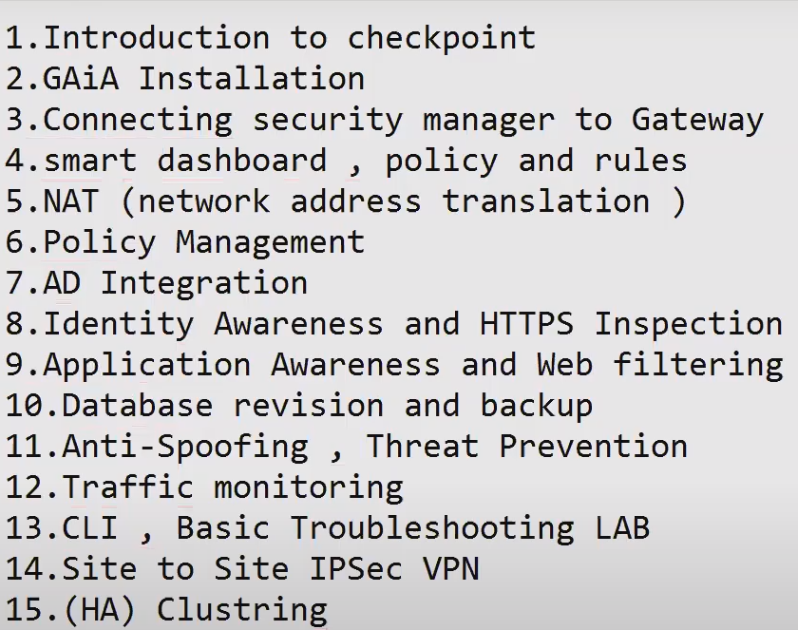

Slide 2
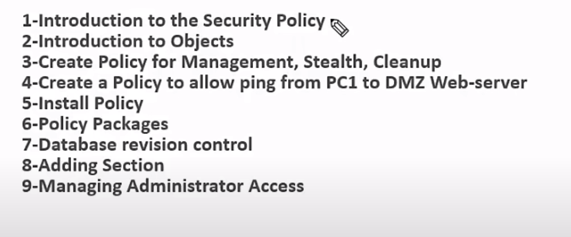
Lab Task List

Slide 3
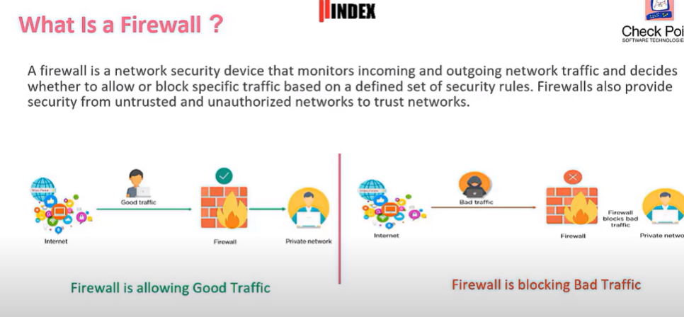

Slide 4
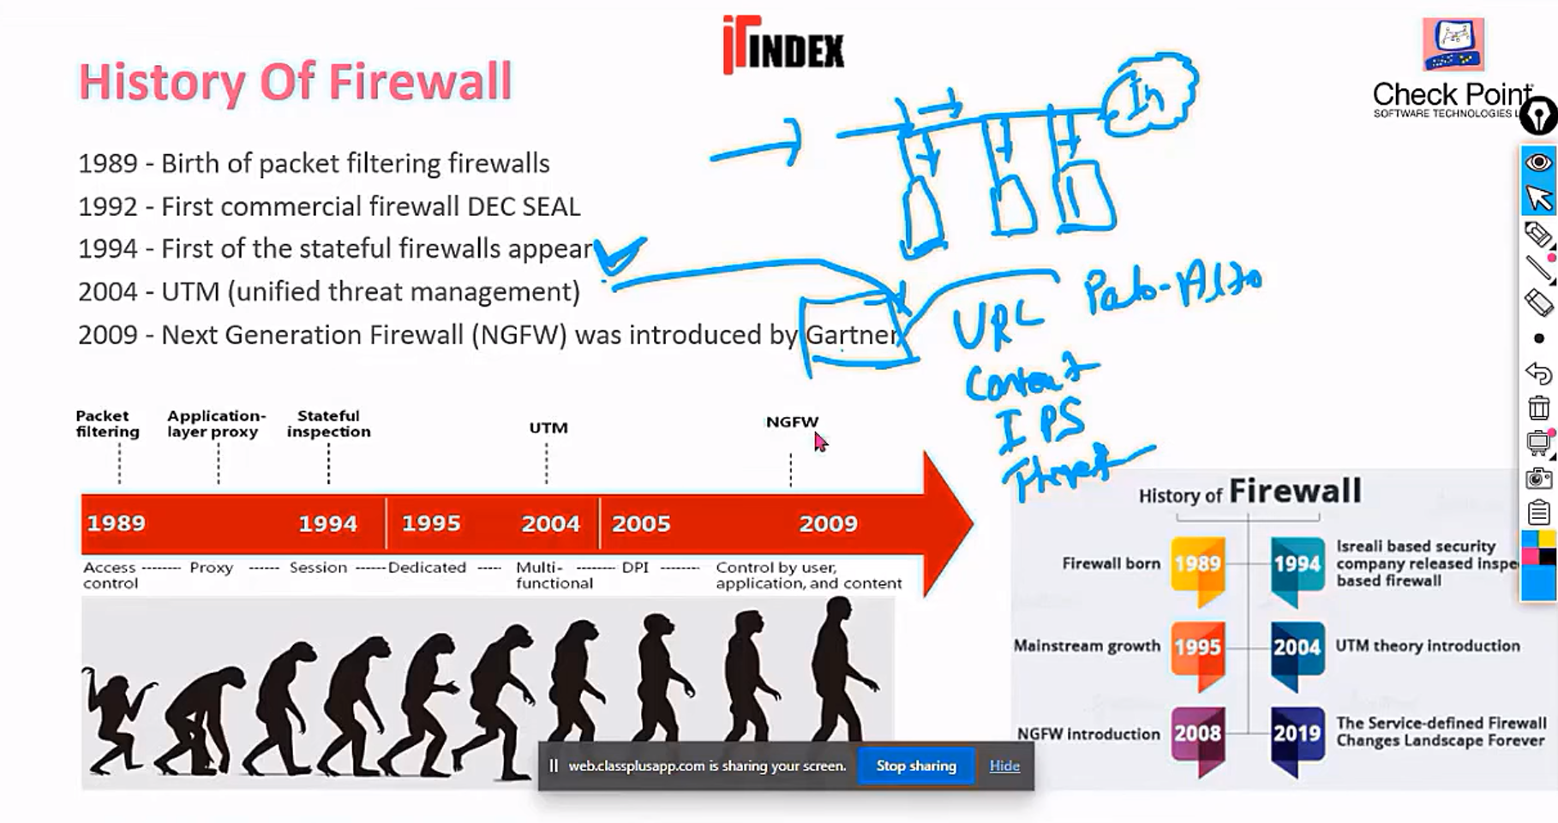

Slide 5
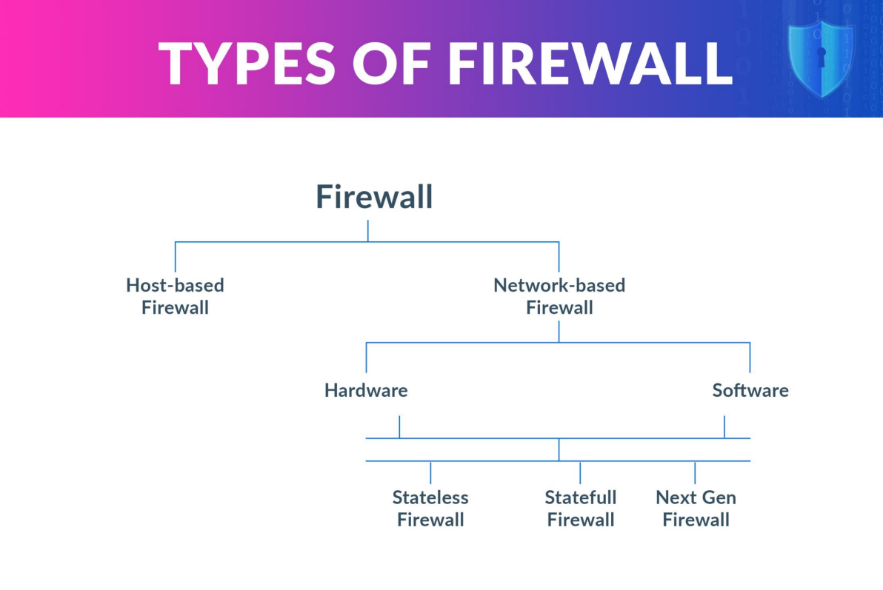

Slide 6
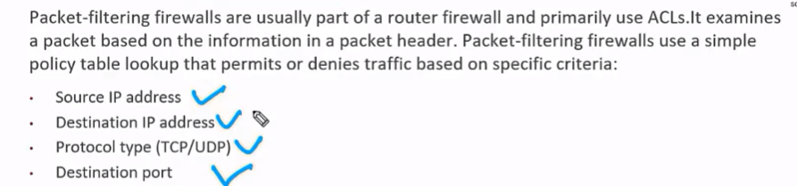
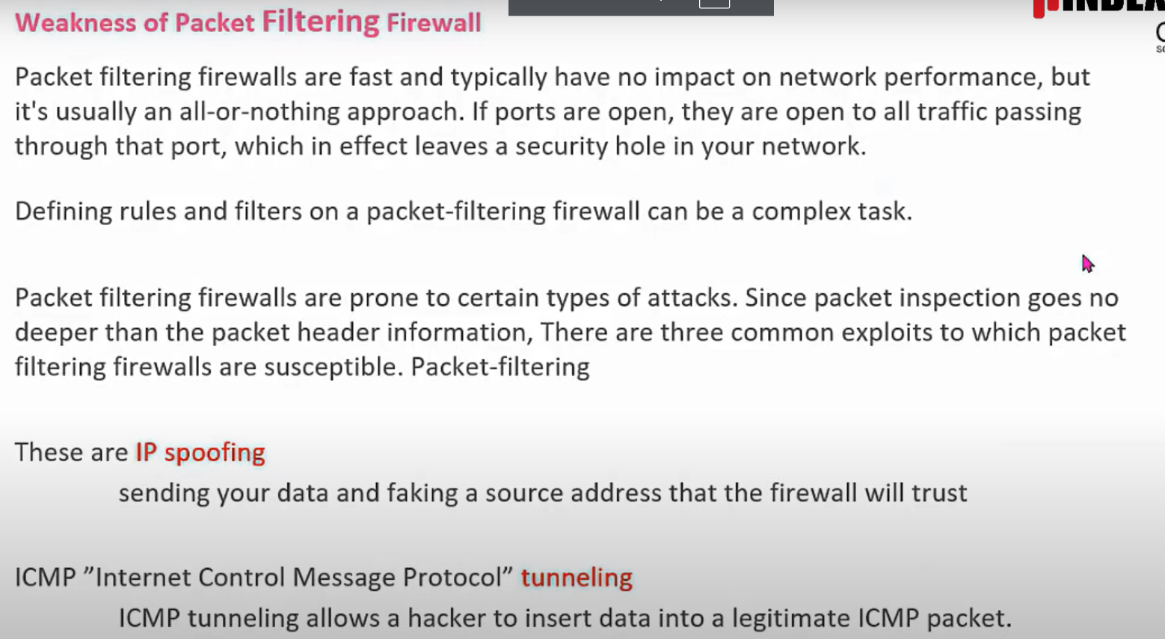
Packet filtering/first generation/ stateless firewall
Introduced by cisco

Slide 7
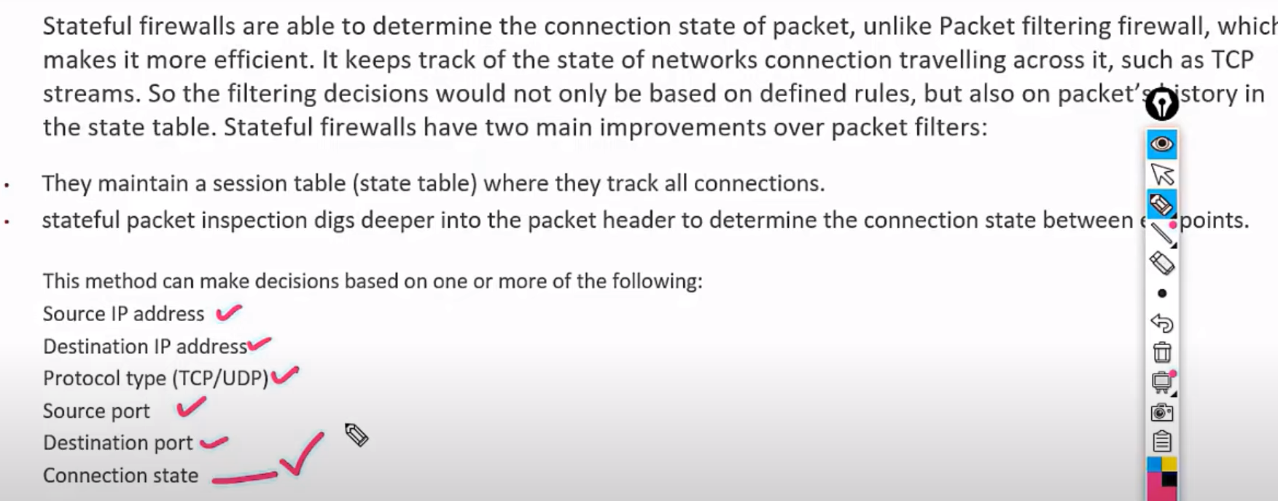
Stateful / connection oriented / second generation firewall
Introduced by Checkpoint

Slide 8
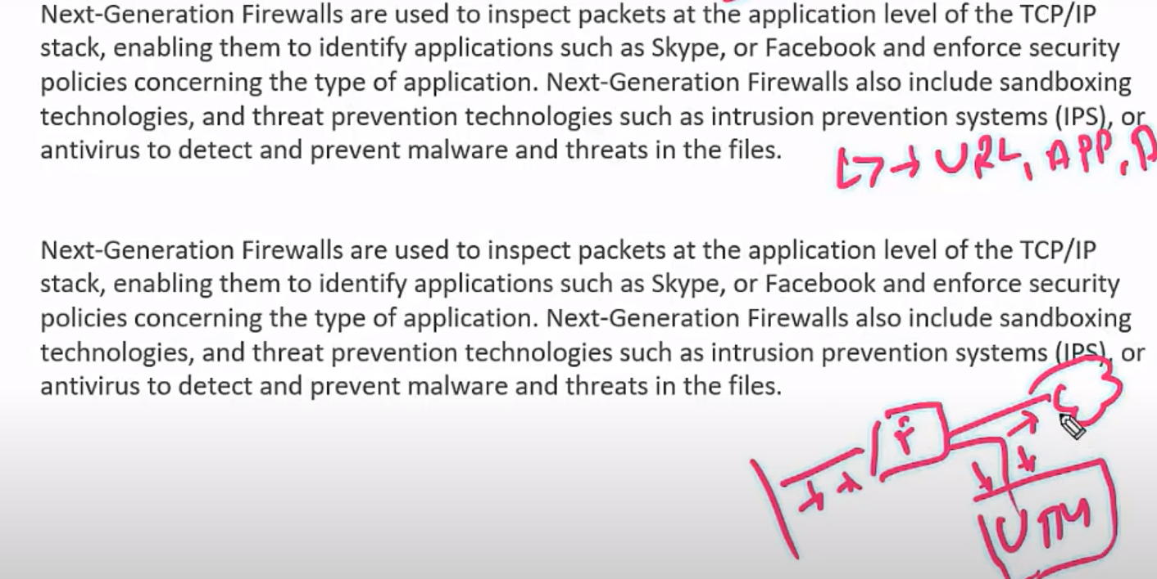
Next Generation Firewall
Introduced by palo alto - 2004

Slide 9

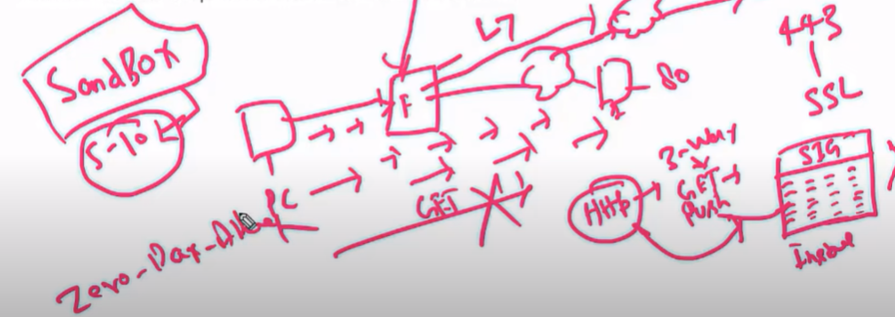
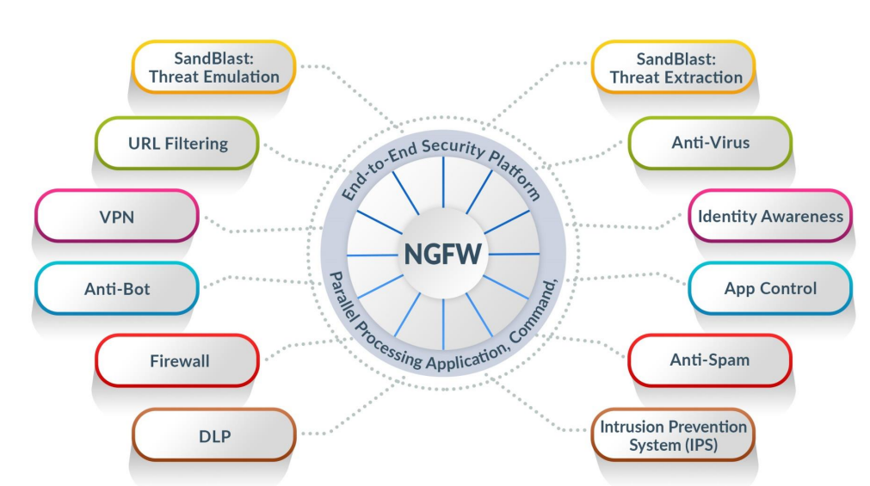
Next Generation Firewall
Introduced by palo alto

Slide 10
Next Generation Firewall
Introduced by palo alto
A sandbox in Check Point is like a virtual testing lab where suspicious files are safely tested to protect your network from hidden threats.
Why use it?
Sometimes, a file (like an email attachment or downloaded software) might look safe but could be hiding a virus or malware. Instead of running it directly, Check Point sends it to the sandbox.
There, the file is:
Opened and observed,
Checked to see if it acts like a virus (e.g., trying to steal data, change files, connect to hackers).
If it behaves badly, it's blocked before reaching your computer.
2.

Slide 11
🕳️ What is a Zero-Day Attack?
A Zero-Day Attack is a cyber attack that uses a software flaw (vulnerability) that the software maker doesn’t know about yet.
"Zero-day" means the company has had zero days to fix it.
Hackers use this hidden flaw to break into systems before it's patched.
🦠 Example:
Imagine a door in your house has a secret crack no one knows about. A thief finds it and sneaks in before you even know the crack exists. That’s a zero-day attack.
🛡 How Check Point Prevents Zero-Day Attacks
Check Point uses multiple advanced technologies to stop zero-day threats before they cause damage:
✅ 1. SandBlast (Sandboxing Technology)
Suspicious files (PDFs, Word docs, executables) are opened in a virtual sandbox.
The file is watched closely — if it tries to do something bad (like install malware), it's blocked.
Even if the malware is new and unknown, the behaviour gives it away.
✅ 2. Threat Emulation
Files are run in a cloud-based or on-premises sandbox.
Check Point watches for dangerous actions (like file encryption or network communication with hackers).
Stops threats before they enter your real network.
✅ 3. Threat Extraction
Removes risky parts (macros, scripts, embedded code) from documents.
Sends a clean, safe version to the user — instantly.
Even if the file was zero-day malware, the harmful part is stripped.
✅ 4. Threat Cloud Intelligence
Global real-time database of known and unknown threats.
If a zero-day attack is detected somewhere, the info is shared worldwide within seconds.

Slide 12
🔐 SandBlast Suite Includes:
Component Description
Threat Emulation Sandboxes suspicious files (e.g., PDFs, Office files) to detect zero-day attacks
Threat Extraction Removes active content (macros, scripts) from files for safe delivery (even if malicious)
Threat Cloud Integration Leverages Check Point's cloud intelligence for malware verdicts
Zero-Phishing Protects against fake login pages and phishing sites
Anti-Ransomware Endpoint-level defense against ransomware attacks
Forensics & Reporting Detailed incident analysis and visibility (in SandBlast Agent/Portal)

Slide 13
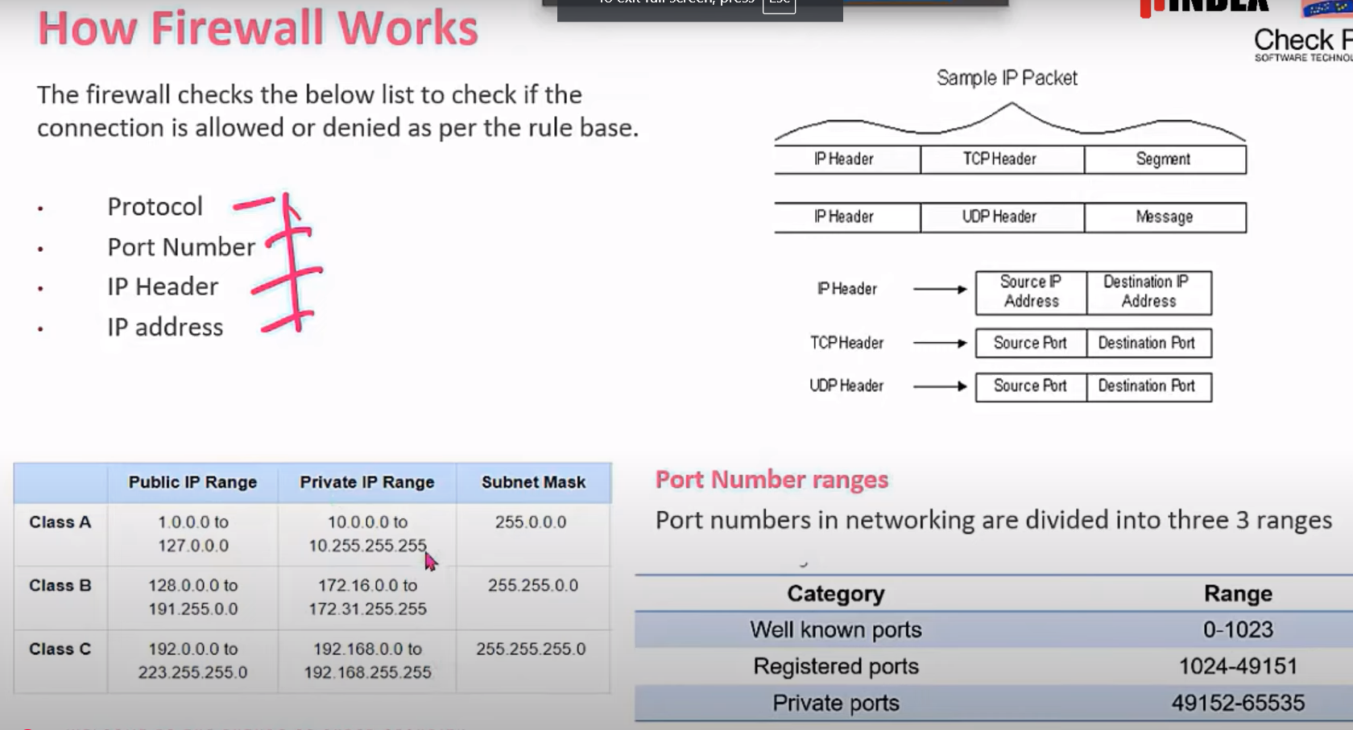
How Firewall Works

Slide 14
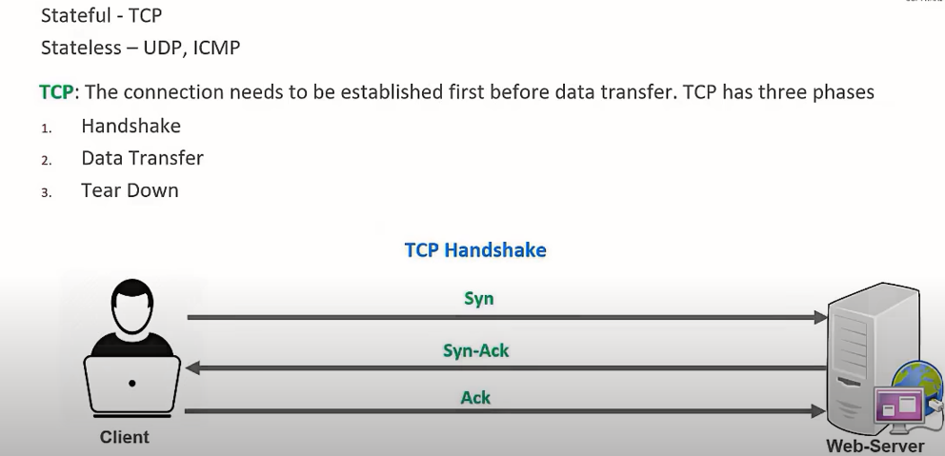
Stateless And Stateful Firewall (TCP & UCP)

Slide 15
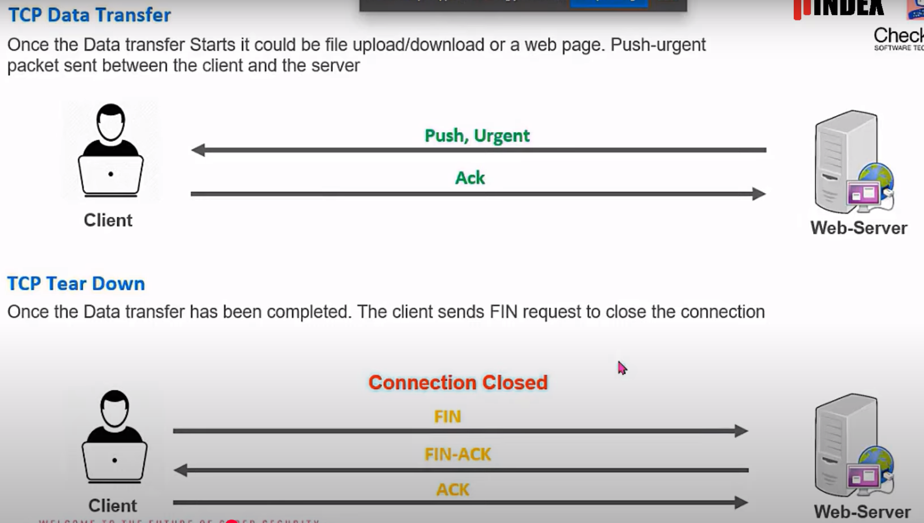

Slide 16
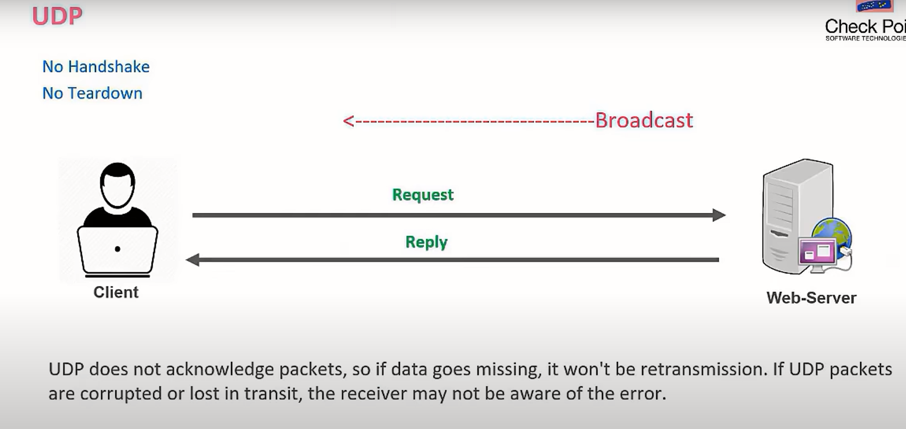

Slide 17
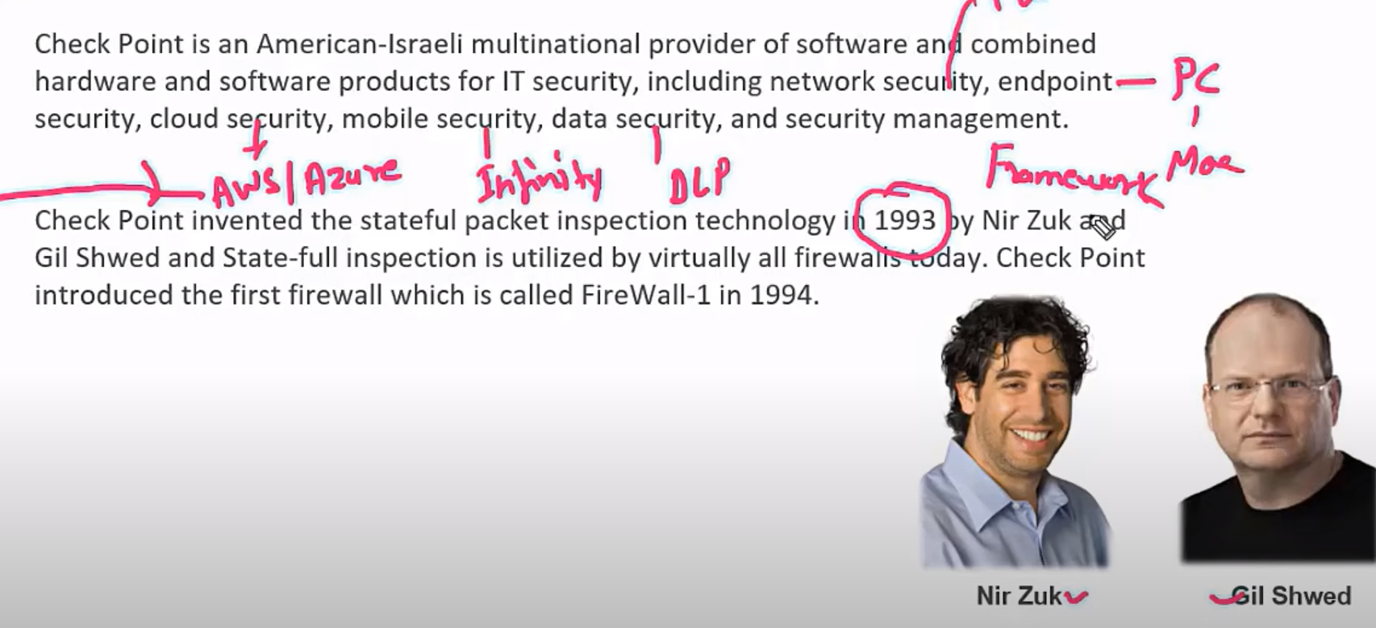
Which TCP states indicate firewall is blocking Checkpoint History
TCP State Indicates Firewall Blocking?
SYN_SENT Waiting for handshake reply 🔥 Very likely
ESTABLISHED Connection is up, but no data or slow 🔥 Possible (data blocked)
CLOSE_WAIT / RST Remote closed or dropped connection 🔥 Possibly due to filter or intrusion prevention

Slide 18
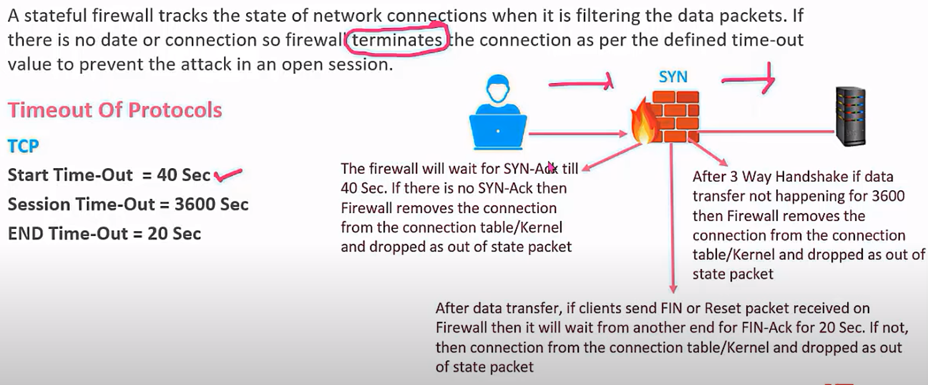
Benefits of Stateful Inspection (Timeout Protocols)
We can modify all timeout, but it will affect all the services and ports, not a specific one.
Which TCP state indicates that the firewall is blocking traffic?

Slide 19
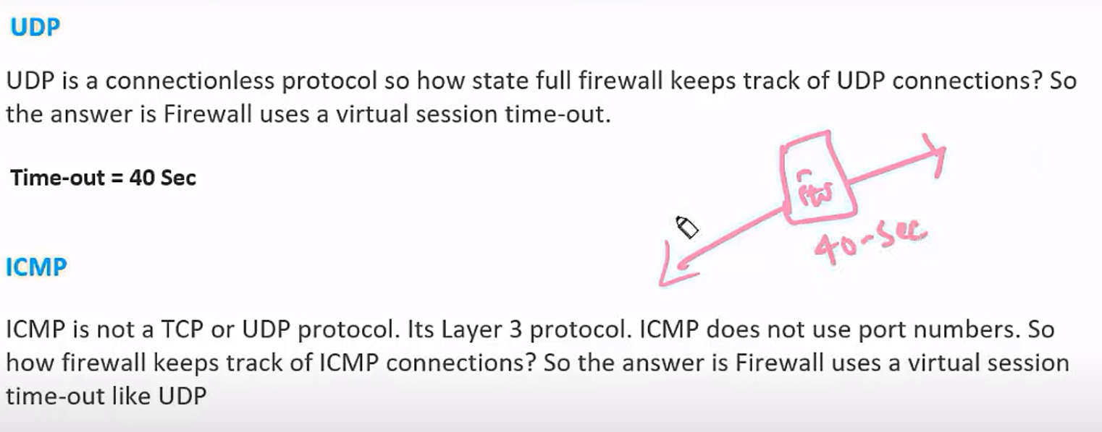
Benefits of Stateful Inspection (Timeout Protocols)

Slide 20
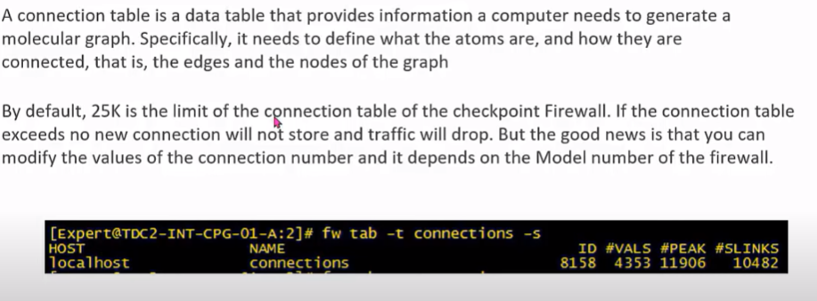
Connection Table

Slide 21
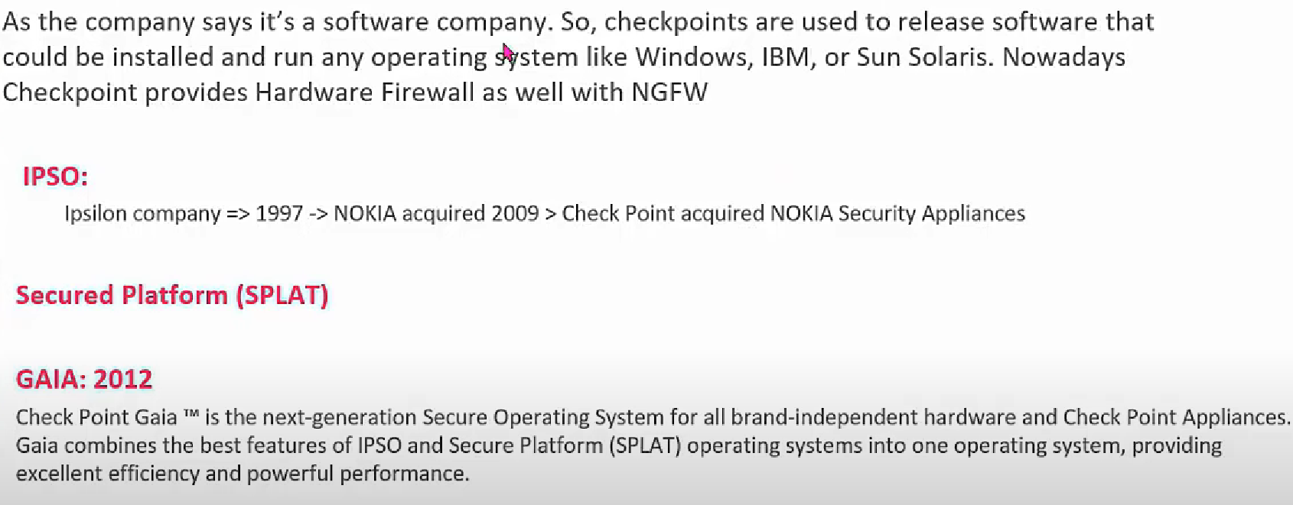
Checkpoint firewall & IOS

Slide 22
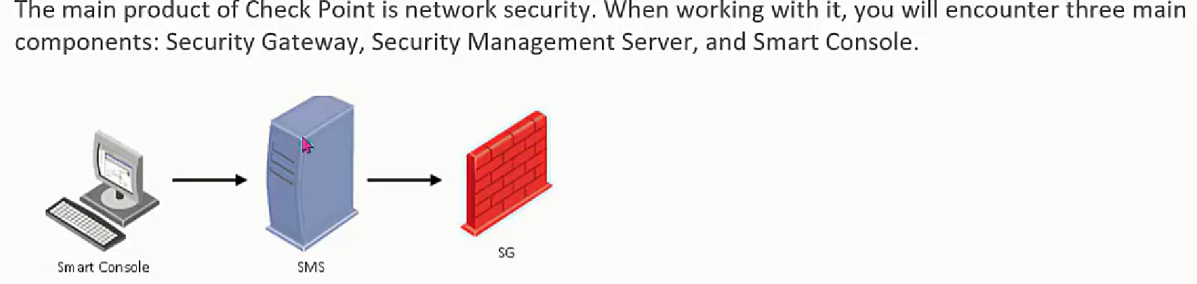
Three Tier Architecture
🧱 3-Tier Architecture in Check Point (Simple Meaning)
🖥️ Smart Console (Tier 1 – Client)
This is the software tool (GUI) that an admin uses.
You open Smart Console on your PC to create, edit, and manage firewall rules (security policies).
Think of it like a remote control.
🖥️ Security Management Server (SMS) (Tier 2 – Brain)
This server stores and manages all the security policies.
It receives changes from the Smart Console and sends policies to the firewalls.
It acts as the central controller.
🔥 Security Gateway (SG) (Tier 3 – Firewall)
This is the actual firewall device that filters and protects the network.
It applies the security policies received from the SMS.
It blocks or allows traffic based on the rules.

Slide 23
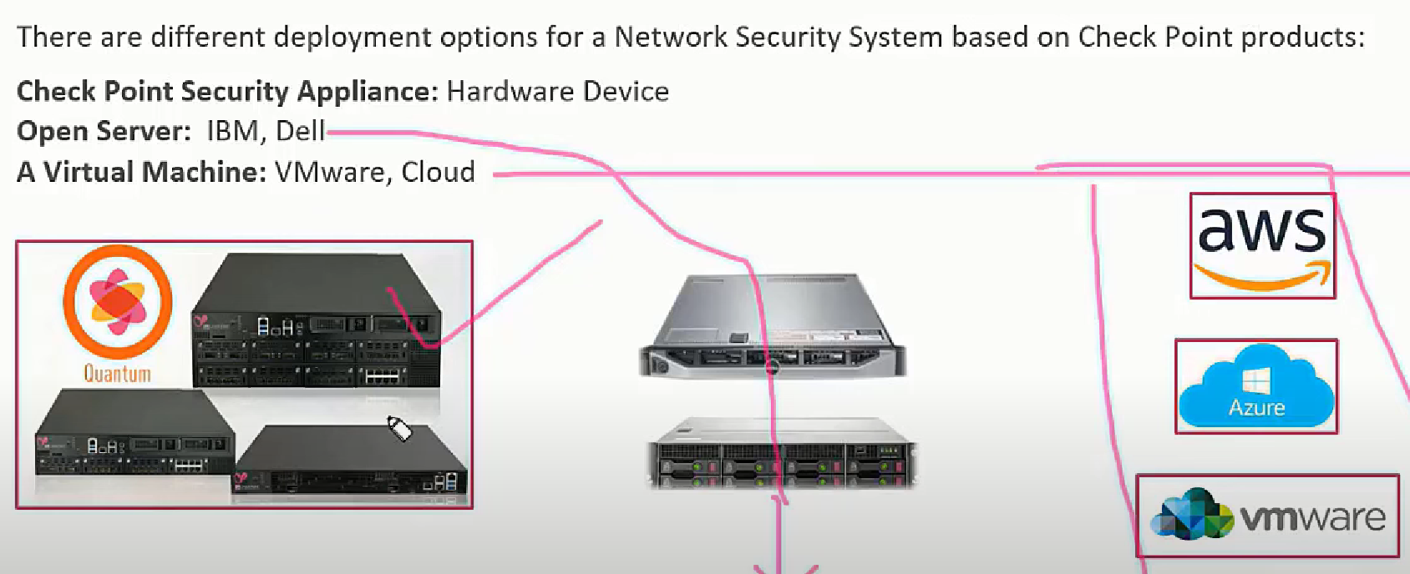
Installation Deployment Option

Slide 24
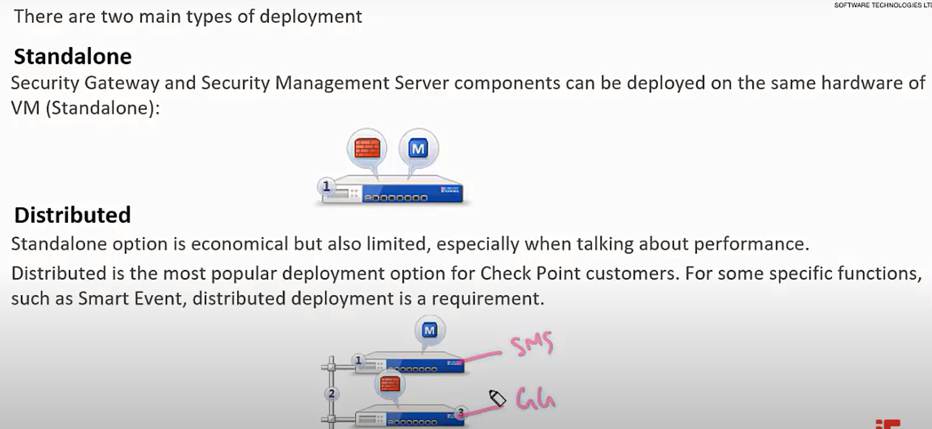
Checkpoint Deployment

Slide 25
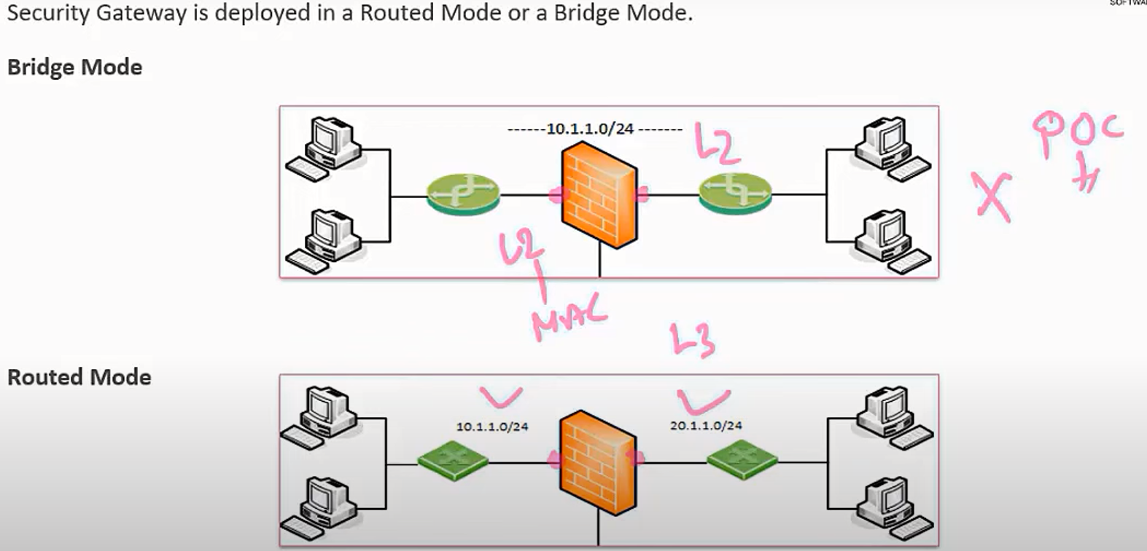
Security Gateway Deployment
Based on Mac-address Based on IP address

Slide 26
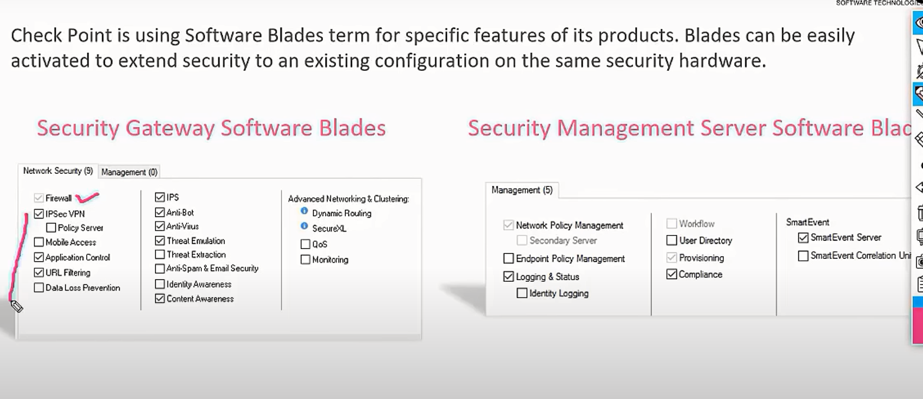
Checkpoint Software Blades
By default, in blades, firewall found in active mode, others are down.

Slide 27
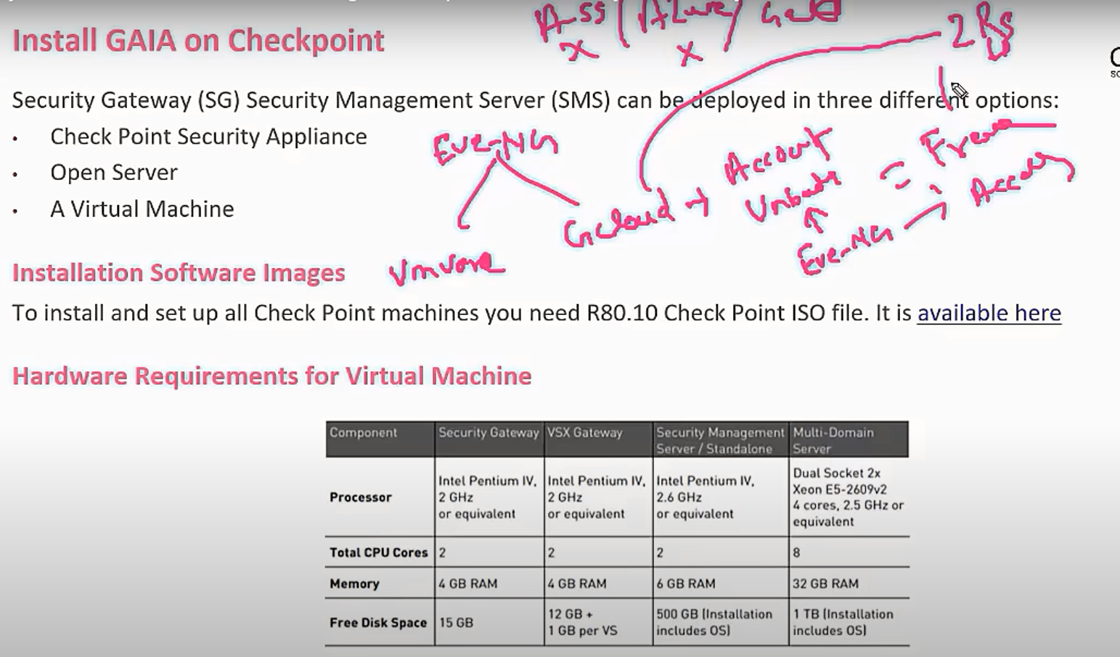
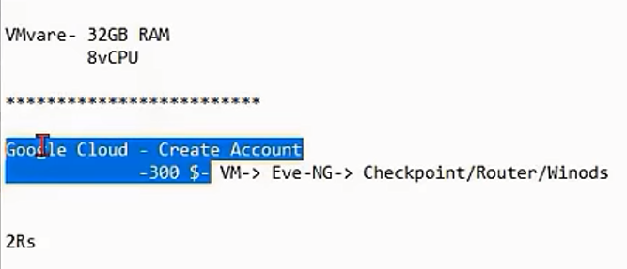
INSTALL GAIA ON CHECKPOINT

Slide 28
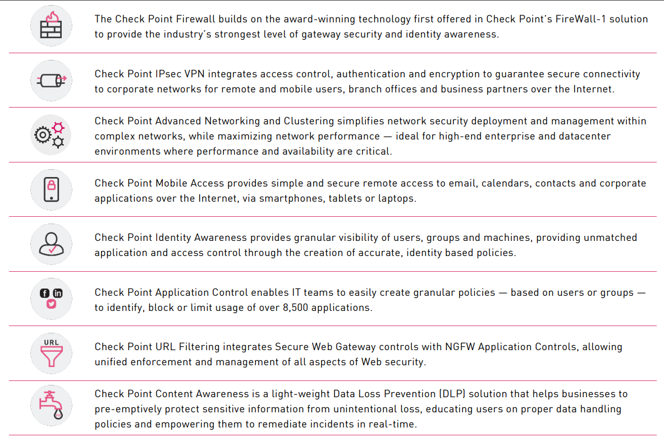
Checkpoint Network Security

Slide 29
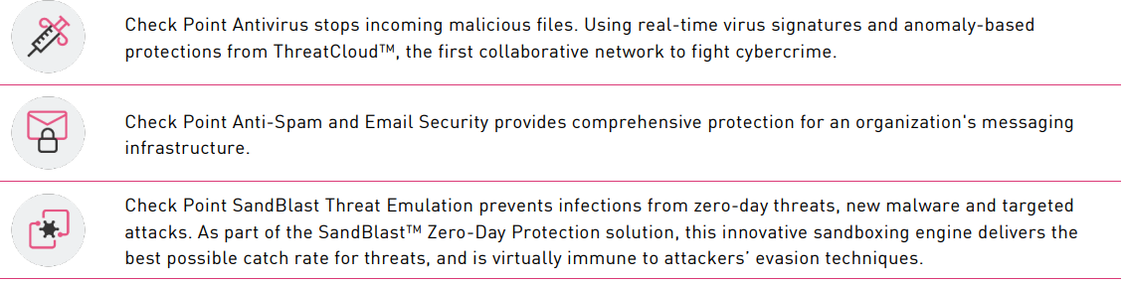
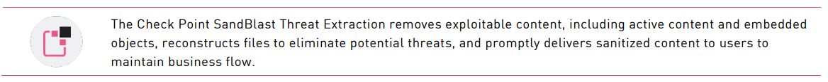
Checkpoint Network Security

Slide 30
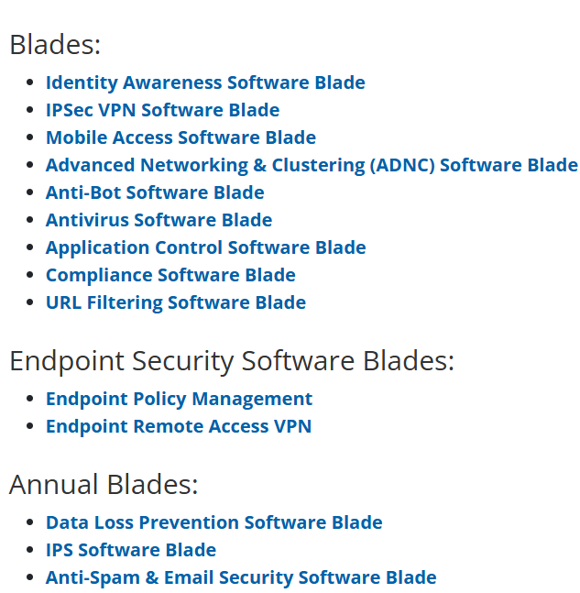
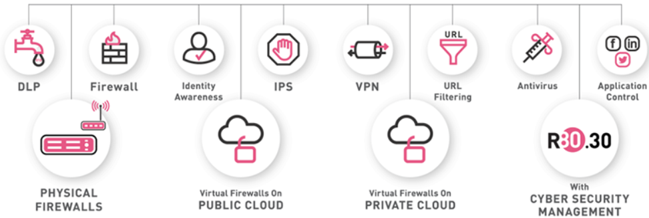
Checkpoint Blades

Slide 31
Identity Awareness Software Blade
🛡️ Identity Awareness Software Blade – Check Point
The Identity Awareness blade in Check Point firewalls enables user-based access control rather than just IP-based rules. It allows the firewall to recognize users and groups and apply security policies based on user identity, device, and role — not just IP address.
👤 What It Does
Feature Description
User Authentication Maps users to IP addresses in real-time.
Identity-based Policies Apply rules like: "Allow access to HR portal for HR group only."
Multi-source Integration Integrates with AD, RADIUS, LDAP, Terminal Servers, VPNs, etc.
Seamless User Mapping No need for users to authenticate every time — uses background mapping.
🔐 Security Use Cases
Enforce different internet access levels for users (e.g., employees vs. contractors).
Grant file share or server access based on AD groups.
Monitor user activity (who accessed what and when).
Ensure compliance in BYOD or shared device environments.

Slide 32
Check Point IPSec VPN Blade
🛡️ Check Point IPSec VPN Software Blade – Explained
The IPSec VPN Software Blade in Check Point firewalls allows you to securely connect remote offices, branches, cloud environments, or remote users to the internal corporate network over the internet, using encrypted IPSec tunnels.
🔑 Core Purpose
The IPSec VPN blade provides:
Site-to-Site VPN: Secure tunnels between different physical or cloud-based networks.
Remote Access VPN: Secure access for users working remotely (via VPN clients or browser-based portals).
Encryption & Authentication: Uses IPSec protocols to ensure confidentiality, integrity, and authenticity of data.
✅ Real-World Use Cases
Use Case How IPSec VPN Blade Helps
🌐 Branch office connectivity Establishes secure site-to-site tunnels
💻 WFH employees Enables remote users to access internal resources
🏢 Data center interconnection Secures links between physical or cloud environments
🛡️ Regulatory compliance Encrypts sensitive data in transit

Slide 33
Check Point Mobile Access Software Blade
🛡️ Mobile Access Software Blade – Check Point Explained
The Mobile Access Software Blade in Check Point firewalls enables secure, clientless or client-based remote access to corporate resources for mobile users, partners, and employees — from anywhere, using any device (laptop, phone, tablet).
🎯 Purpose
Provides SSL VPN access via web browsers or Check Point clients.
Allows remote access to email, web apps, file shares, CRM systems, intranet, and more.
Ensures access is secure, encrypted, and policy-controlled.

Slide 34
Check Point Adv Networking & Clustering Blade
🛡️ Advanced Networking & Clustering (ADNC) Software Blade – Check Point Explained
It provides high availability, scalability, and advanced networking capabilities. It ensures traffic resilience, performance tuning, and uninterrupted network security in complex or large-scale environments.
💡 Use Cases
Scenario ADNC Helps By...
Redundant Firewalls ClusterXL ensures no downtime if a gateway fails
Multiple Internet Links ISP Redundancy provides seamless WAN failover
L3 Enterprise Network Advanced routing allows full OSPF/BGP integration with core routers
Virtual Data Centers (VSX) Supports clustering of virtual systems (with VSLS, etc.)
VoIP/Video Streaming Multicast routing ensures efficient distribution

Slide 35






Check Point Anti-Bot Blade
🛡️ What is Anti-Bot in Check Point (and in general)?
Anti-Bot is a threat prevention feature that protects your network from devices that are infected with malware and try to communicate with Command and Control (C&C) servers on the internet.
🔍 Purpose of Anti-Bot
Anti-Bot detects and blocks:
Infected hosts inside your network trying to call home to an attacker's server.
Communication with botnet C&C servers.
Data exfiltration attempts by malware.
Participation in DDoS attacks, spam, or other malicious activities.
🦠 1. Preventing Botnet Infections in Corporate Networks
Scenario: An employee unknowingly installs a malicious PDF from an email
Hacker
Server
firewall
SW
p1
p4
Infected
p2
p3

Slide 36
Check Point Anti-Virus Blade
🛡️ Antivirus Software Blade – Check Point Explained
The Antivirus Software Blade is a core threat prevention feature in Check Point firewalls. It protects your network by detecting and blocking malware in real-time — including viruses, worms, Trojans, spyware, and more — at the gateway level, before the threat reaches user devices.
🔍 What It Does
Scans incoming and outgoing files over protocols like HTTP, SMTP, FTP, SMB, and HTTPS.
Uses signature-based detection (known malware) and heuristics (unknown/suspicious behavior).
Blocks or quarantines infected files and alerts administrators.
Works in real-time with
continuous updates from Check Point's ThreatCloud.
📈 Heuristic Analysis Detects unknown/new malware based on behavior patterns

Slide 37
Check Point Application Control Software Blade
🌐 Check Point Application Control Software Blade – Explained
The Application Control Software Blade in Check Point firewalls allows you to identify, control, and
block applications and web services — improving security, visibility, and productivity across your network.
🎯 Purpose:
To monitor and control:
Which applications and web services users can access
Who can use them
When and from where they can use them
EG: A company wants to allow Microsoft Teams, block TikTok, and limit YouTube bandwidth after 6 PM.
✅ Application Control allows all this through SmartConsole policy rules.

Slide 38
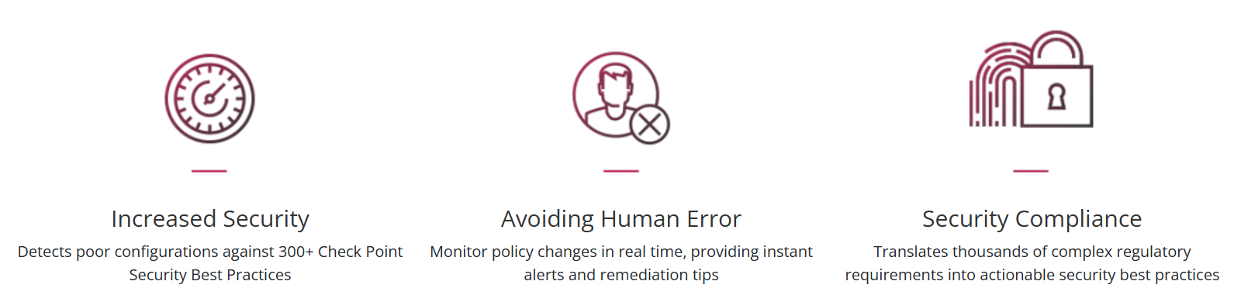
Check Point Compliance Software Blade
🌐 Check Point Compliance Software Blade– Explained (Compliance means "following the rules.")
Boost your security level across your entire Check Point environment with a dynamic security compliance solution that continuously monitors your security infrastructure, gateways, blades, policies and configuration settings all in real time.

Slide 39
Check Point URL Filtering Software Blade
🌐 Check Point URL Filtering Software Blade – Full Overview
The URL Filtering Software Blade helps organizations control and monitor access to websites based on URL categories, user identity, and time, improving both security and productivity.
🎯 Purpose:
To allow, block, limit, or monitor web traffic by URL or category — with user-based, content-aware policies.

Slide 40
Check Point URL Filtering Software Blade
🖥️ Check Point Endpoint Policy Management – Explained
Endpoint Policy Management is a central component in Check Point’s security architecture that allows administrators to define, deploy, and enforce security policies across all protected endpoint devices (laptops, desktops, mobile devices).
🎯 Purpose:
To centrally manage and control endpoint security features, ensuring all user devices comply with organizational security standards.
🔐 What It Protects:
Endpoint Device Types Examples
💻 Desktops & Laptops Windows, macOS
📱 Mobile Devices iOS, Android (via Harmony Mobile)
🌐 Remote Devices VPN-connected or roaming laptops

Slide 41
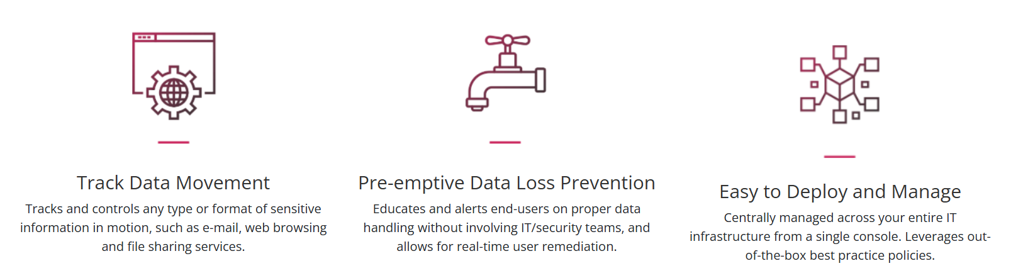
Check Point Data Loss Prevention Blade
🖥️ Check Point Data Loss Prevention Blade: (Remediate -- fix, resolve, or mitigate) Check Point Data Loss Prevention (DLP) Software BladeTM combines technology and processes to revolutionize DLP, helping businesses to preemptively protect sensitive information from unintentional loss, educating users on proper data handling policies and empowering them to remediate incidents in real-time.

Slide 42
Check Point IPS Software Blade
🖥️ Check IPS Software: Intrusion Prevention Systems detect or prevent attempts to exploit weaknesses in vulnerable systems or applications, protecting you in the race to exploit the latest breaking threat. Check Point IPS protections in our Next Generation Firewall are updated automatically. Whether the vulnerability was released years ago, or a few minutes ago, your organization is protected.
✅ Check Point IPS (Intrusion Prevention System) protects you by:
Blocking known attacks It stops attacks that are already known, like those listed in security databases (CVEs).
Stopping secret data theft It detects and blocks tricks like DNS tunneling, which hackers use to secretly send data out of your network.
Catching new or unknown attacks Even if an attack isn’t known yet, it can still detect and block it based on suspicious behavior (no need for a signature).
Preventing misuse of network rules It watches for strange or incorrect use of internet protocols, which can be signs of hacking.

Slide 43
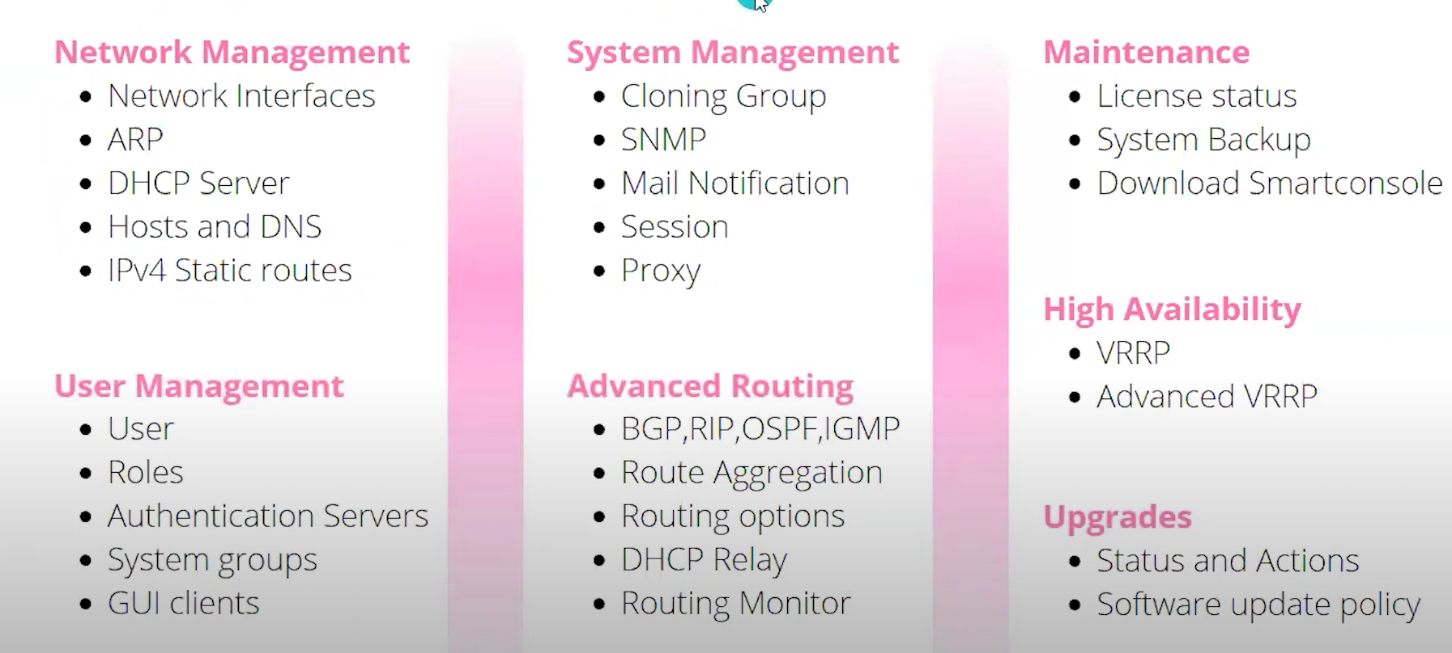
Features Of Gaia

Slide 44
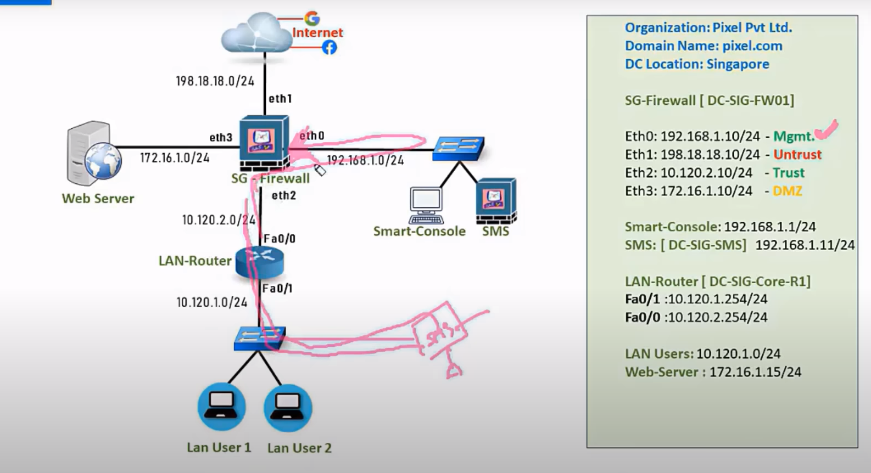

Slide 45
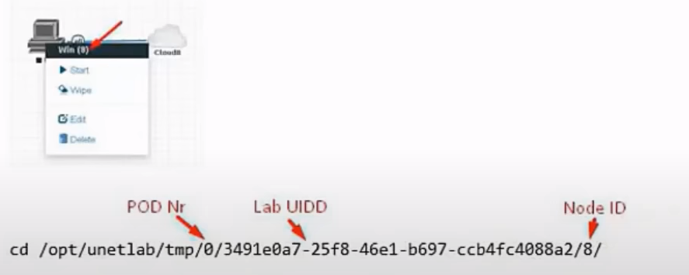
Port no – eve-ng: management-POD
India sms NWL sms US sms
MDS (access using single console)

Slide 46
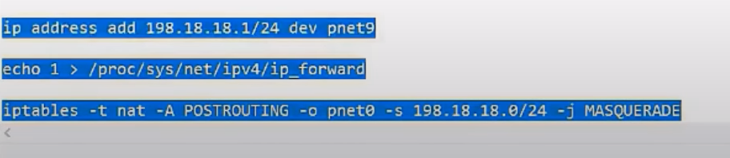
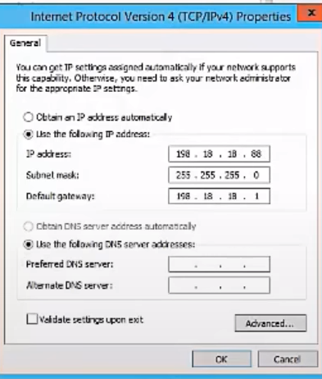
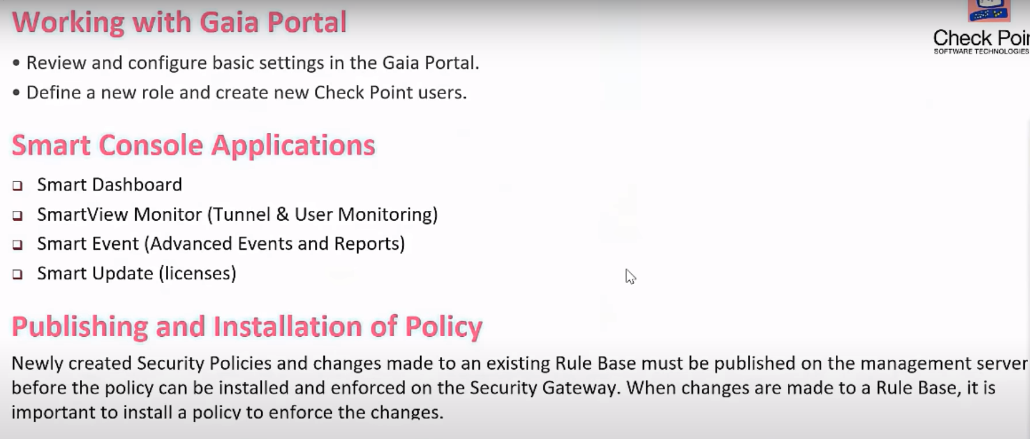
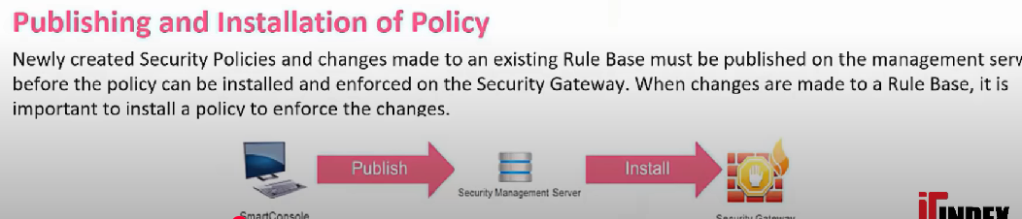

Slide 47
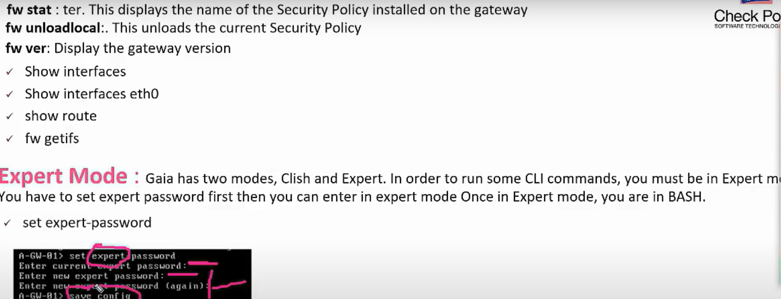
Useful commands and expert mode

Slide 48
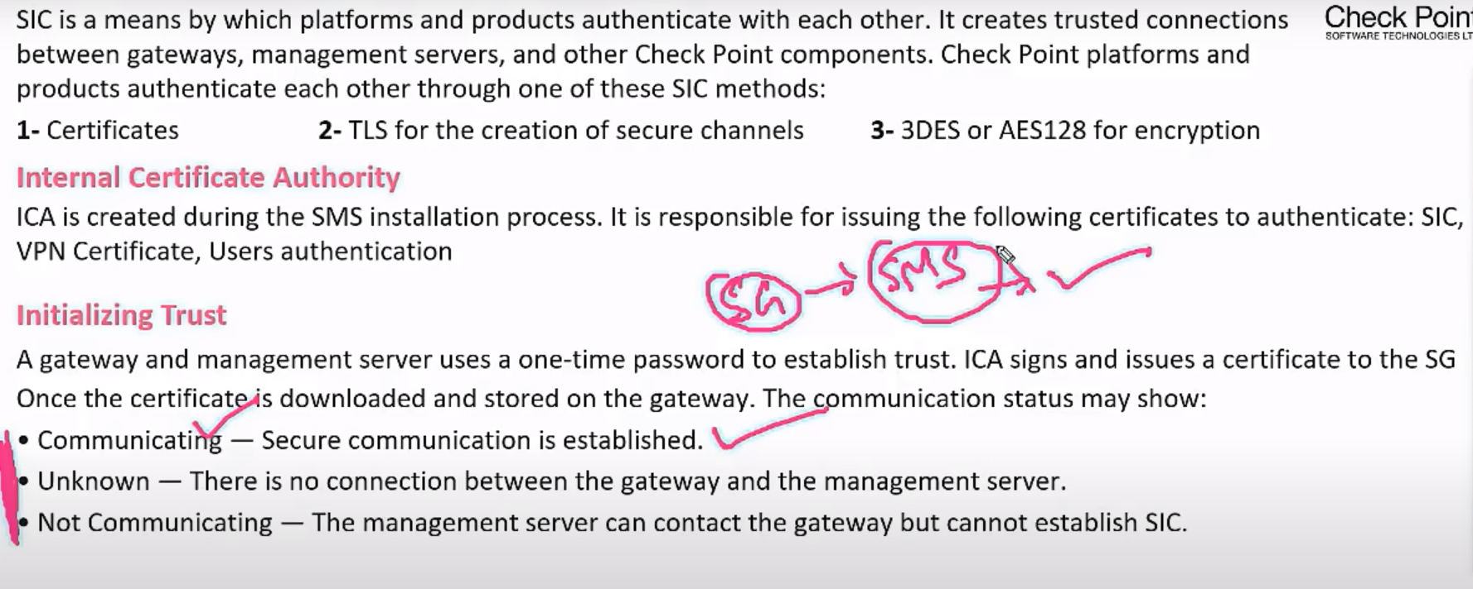
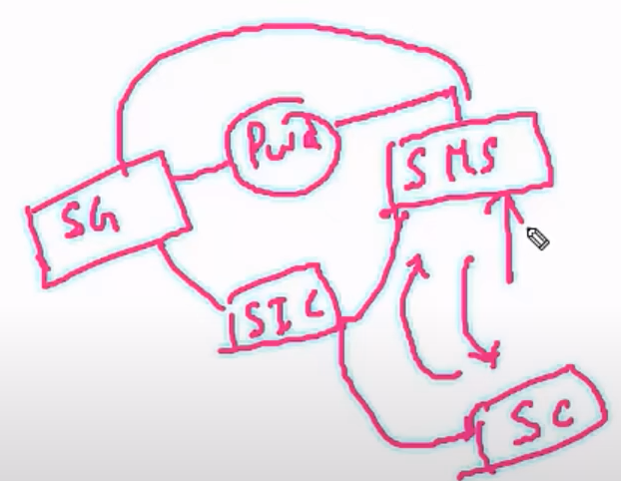
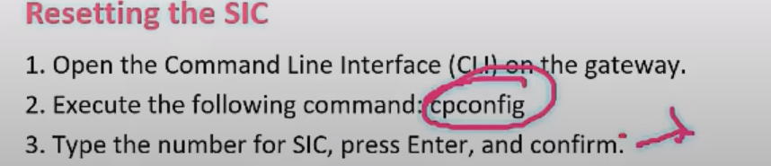
SIC (Secure Internal communication)

Slide 49
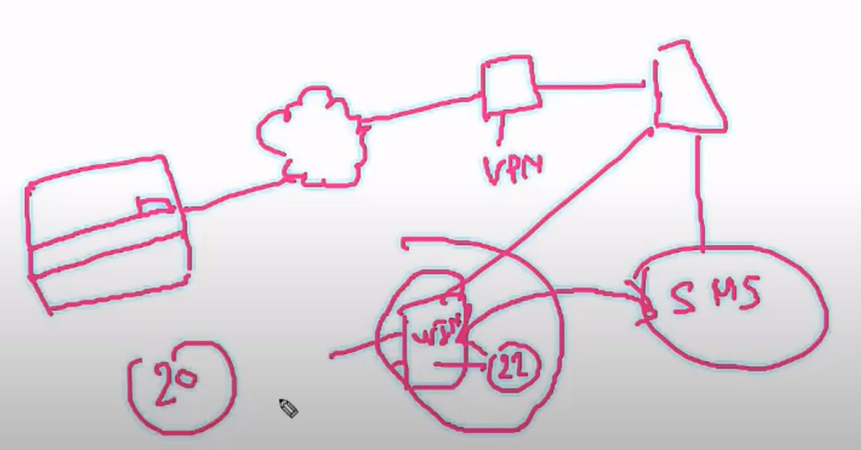
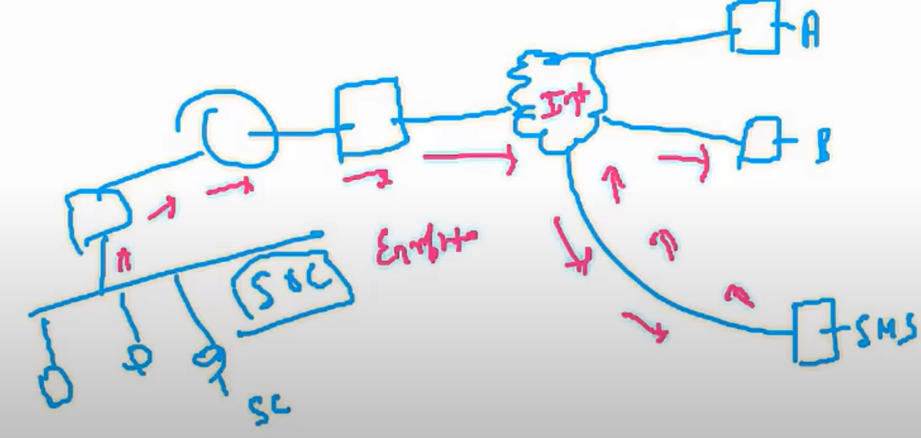
SIC (Secure Internal communication)
DEF: In Checkpoint (a cybersecurity company), ICA as "Internal Communication Authority" likely refers to a system or protocol that manages secure communication within a network or organization.
Simple Explanation:
Internal Communication = Messages, data, or commands shared inside a company or network.
Authority = Controls who can send/receive information and ensures security.
What Does ICA Do in Checkpoint?
Secure Messaging – Keeps internal chats, emails, and file transfers safe from hackers.
Access Control – Decides which employees/devices can communicate with each other.
Monitoring – Watches for suspicious activity in internal networks.

Slide 50
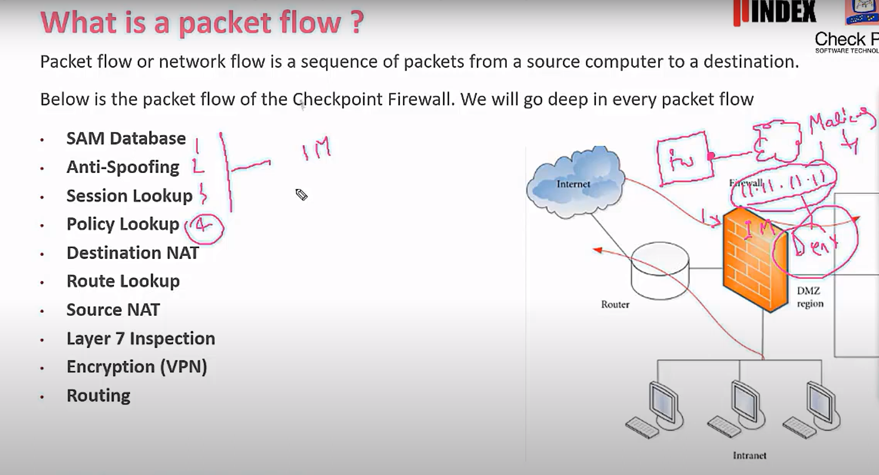
Packet Flow in Checkpoint

Slide 51
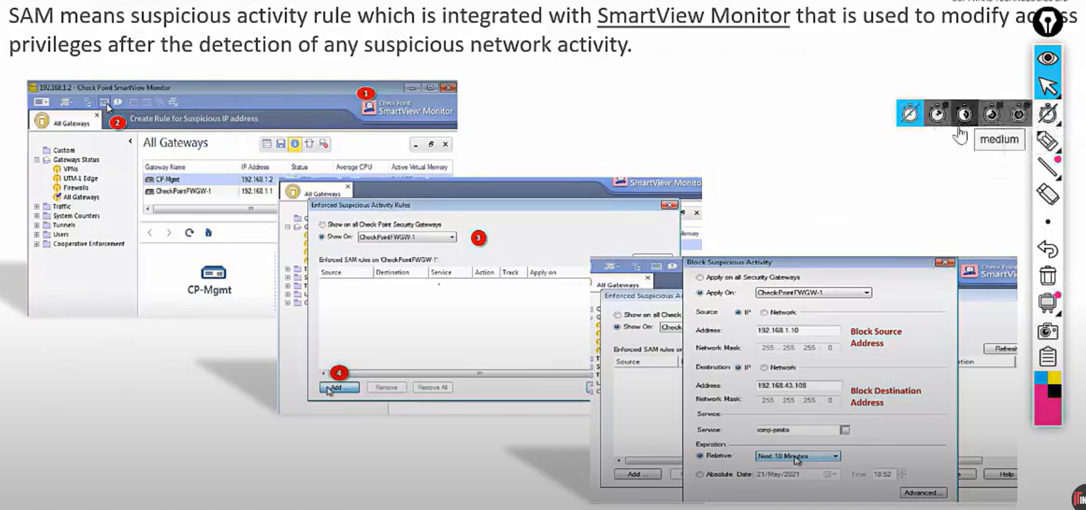
SAM DATABASE (GSACK TEAM)

Slide 52
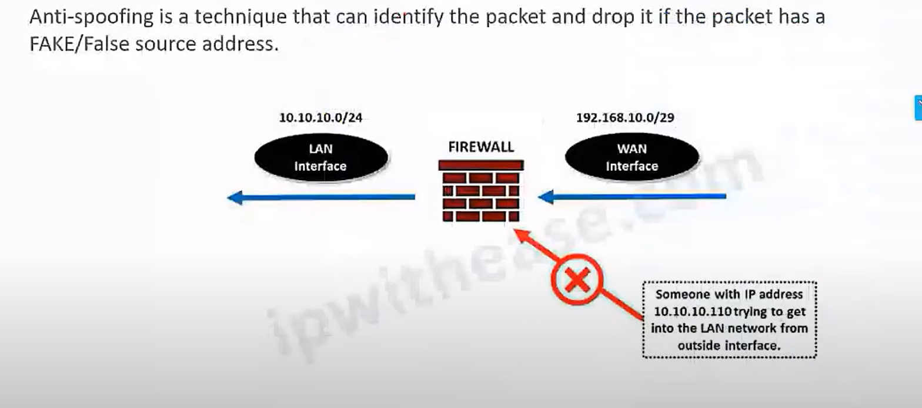
Anti-Spoofing

Slide 53

Anti-Spoofing
2 types:
Slow path – if there is no existing session in session table
Fast path – if there is existing session in session table then there will be no policy checkup

Slide 54
✅ Definition:
Slow Path refers to the full inspection path, where a packet is sent to the Firewall Kernel for:
Rule matching,
Application layer inspection,
Threat prevention (IPS, Anti-Bot, etc.).
⚙️ When it's used:
First packet of a new session (connection).
When a packet needs Deep Packet Inspection (DPI).
When acceleration (SecureXL) is disabled or not applicable.
Certain traffic types: fragmented packets, encrypted traffic inspection, or policy exceptions.
Feature Fast Path (SecureXL) Slow Path (Firewall Path)
----------------- ------------------------------ -------------------------
Speed Very fast Slower
Used for Known, accepted sessions New or complex traffic
Inspection Level Minimal (metadata) Full, deep inspection
CPU Load Low Higher
SecureXL Used? Yes No
Example HTTP stream after first packet First SYN packet

Slide 55


Policy Lookup & Destination Nat

Slide 56

Route Lookup, Source Nat & Layer 7 Inspection

Slide 57

Encryption & Routing
If disable: then the packet flow is different SecureXL is Check Point’s packet acceleration engine, implemented as a kernel-level driver that handles the processing of connections without needing to pass every packet through full firewall inspection.

Slide 58

Security Policy Management

Slide 59

Types of rules in the rule base

Slide 60

Creating a Basic Access Control Policy

Slide 61

Objects

Slide 62



Create Policy using Smart Console
Smart Console > Security Gateway > rule (new_object) > publish (sc – sms db) > install policy (sms-save_firewall)
Slide – 60 = Steath Rule
Section

Slide 63




Create a domain in WEB_SERVER
Server roles:
Active directory Domain Services next next install
ADD roles & feature
Server roles – Web server (checkbox)

Slide 64



Right click>

Slide 65



Policy Packages & Database Revisions

Slide 66


One management, two firewalls at different places
Error failing: installation failed. Reason: Tcp connectivity failure (port = 18191) (IP = 105.0.0.254) (error no.10) ans: check you might have two default gateway address or we have not configured gateway
Check: Address Spoofing

Slide 67


Diff Policy Package For Different Firewall
Edit policy (RMB) > specific gateways > select firewall

Slide 68

NAT

Slide 69

NAT (Network Address Translation)

Slide 70


Types Of NAT
Source Nat
Destination Nat
Translation of source address is called as source nat.
(network accessibility of lan)
Translation of destination address is called as destination nat.
(host your internal services)

Slide 71

PAT (Port Address Translation)(Redirect)

Slide 72

Hide Nat(PAT)
Why it translates the port no?

Slide 73

Static Nat

Slide 74
Give access to internet
Create an ACL to allow a LAN user to go through firewall
Translate the private IP to public IP
If we want auto nat:
i. Double click on object > ii. Select the enable the auto nat opt1: hide behind the gateway - which will use the firewall exit interface ip opt2: hide behind the ip address - we have to manually give the ip
2. Manual nat (it uses the concept of proxy arp) i. create an acl ii. Create manual nat > translated source > hide nat
When we use auto NAT on a firewall, it will create Proxy ARP table in firewall. When we create manual NAT, the IP is provided by the user which is unknown to the firewall that is why we have to define the proxy arp.

Slide 75




Why do we need proxy Arp if we manually configure the Nat policy in checkpoint??

Slide 76
Solve the manual NAT
Steps
In the firewall of Gaia configure the proxy arp for manual nat ip
Check the tcpdump
More local.arp (check whether or not the fire get created)
Install the policy
Go to smart console > global properties > NAT > merge the proxy arp table

Slide 77



Backup & Restore

Slide 78
Backup & Restore

Slide 79
Backup & Restore

Slide 80

Policy Layers
In Check Point, policy layers are used to organize and separate different types of security rules. Instead of managing all rules in a single policy, we can break them into multiple layers — for example, an Access Control layer for traffic rules, and a Threat Prevention layer for antivirus, IPS, and anti-bot protection. This improves visibility, simplifies rule management, and supports role-based access, so different teams can manage their own layers without affecting others. Also, shared layers can be reused across multiple policies, which helps in maintaining consistency across different gateways.

Slide 81
Inline layers
DEF: An inline layer is like a sub-layer of rules inside a main rule.
📌 Why Use Inline Layers?
More control – You can apply extra rules inside a main rule.
Cleaner policies – Instead of creating many rules at the top level, you organize them under one.
Better logging and visibility – You can track which rule inside the inline layer matched in rule.
🚦How It Works (Simply):
Traffic hits a main rule with an inline layer.
Instead of allowing/denying directly, it checks the rules inside the inline layer.
Based on those sub-rules, it takes action.
🧾 Example (Visual):
Rule # Source Destination Action
1 HR Net Internet Inline Layer → (checks sub-rules)
2 Admin Internet Allow
Inside Rule #1 Inline Layer:
Allow HTTP
Allow HTTPS
Block FTP
Log DNS

Slide 82
Ordered layers
Ordered Layers in Check Point mean that multiple policy layers are applied in a specific order, one after the other — top to bottom.
You might have:
Layer 1: Access Control
Layer 2: Application Control
Layer 3: URL Filtering
Each layer checks the traffic one by one, in the defined order.
🧠 How It Works:
Traffic enters the firewall.
It’s evaluated against the first layer.
If matched and allowed, it moves to the next layer.
This continues until all layers are checked.
If any layer blocks the traffic → it’s dropped.

Slide 83


Slide 84

Click on: Accept (action) > select inline layer > newlayer >

Slide 85

TLS Handshake
Client says that server is also need to verified.

Slide 86


Checkpoint Https Inspection (SSL Decryption)
Q. What is https or Deep packet Inspection??
Https inspection blades:

Slide 87

How it works:

Slide 88

Checkpoint Https Inspection
Checkpoint provides an extra layer inspection even if the packet is encrypted using esp. It decrypts the packet and inspect it by using UTM tools.

Slide 89

CISO (Chief Information Security Officer)
CISO decides whether traffic is inspected or not.

Slide 90


Application Filtering

Slide 91


Content Awareness
Content Awareness in Check Point is a Next-Generation Firewall (NGFW) feature that enables the firewall to inspect and control traffic based on the content of the data — not just the source, destination, or service.
Use Cases:
Block file types Enforce size limits
Sensitive data protection
Logging & Monitoring
Any direction – uploading and downloading

Slide 92



Create own policies
Object database

Slide 93
How to add layers inside a layer
Policy > right click > edit policy i. ACCESS control for new layers ii. URL LAYERS > click on the url > check mark on the blade

Slide 94

Create group

Slide 95

Lab Task

Slide 96


Solution

Slide 97

Turn on URL filtering blades (Knowle of Ordered layers)
Option2:
Policy > rightclick > access control > app & url filtering advance: accept (drop)
Option1: Right click on policy > Blades (2 click) if we do this then it will be installed on the same access control policy packge.

Slide 98

Identity Awareness Blade (LDAP & User Directory)
Identity Awareness Blade is used to authenticate a device not only based on IP address but also username and password.

Slide 99

Active Directory

Slide 100

Checkpoint Database
There are two types of database in checkpoint. They are:
Local Database
LDAP
If any traffic comes from local area network, it can use both the tables whether to allow or deny the traffic.
Task:

Slide 101


2. Create a group
3. Create a user
4. Make the user member of that group
Rmb>prop>mem>add
1
Firewall rg

Slide 102
errors
Rule conflict – if they have same rule

Slide 103
Management Tier: The Brains and Central Control
Component: Security Management Server (SMS)
What it is: The SMS is a dedicated server (physical appliance or virtual machine) that runs the Check Point security management software. It's the central repository for all your security policies, objects (like network addresses, services, users), and configurations.
What it does:
Policy Authoring: You define all your firewall rules (e.g., "Allow web traffic from the internal network to the internet," "Block all peer-to-peer applications").
Object Management: You create and manage network objects, users, services, time ranges, and other elements used in your security policies.
Configuration Deployment: Once policies are created, the SMS compiles them and securely pushes them out to the Security Gateways.
Database: It stores the entire security configuration database.
Log Consolidation (Optional/Default): By default, Security Gateways send their logs to the SMS, which can then act as a basic log server. For large environments or advanced analytics, a separate Log Server/Smart Event would be used.

